Slide 1

Note: The data and information in this document is reflective of a hypothetical situation and client. This document is to be used for KPMG Virtual Internship purposes only.
Sprocket Central Pty Ltd
Data analytics approach
[Division Name] - [Engagement Manager], [Senior Consultant], [Junior Consultant]

Slide 2
Note: The data and information in this document is reflective of a hypothetical situation and client. This document is to be used for KPMG Virtual Internship purposes only.
Agenda
Introduction
Data Exploration
Model Development
Interpretation

Slide 3

Note: The data and information in this document is reflective of a hypothetical situation and client. This document is to be used for KPMG Virtual Internship purposes only.
Introduction
Development Roadmap:
Data Cleaning: The dataset will undergo meticulous cleansing to eliminate duplicate entries and rectify any missing values, ensuring its structured integrity.
Data Exploration: Thorough analysis will reveal valuable trends, forming the basis for hypotheses to undergo rigorous testing.
Data Modeling: The Data Modeling process is iterative, involving the derivation, testing, and refinement of multiple models until one aligns with the specified criteria.
Data Evaluation: Data is evaluated using several test metrics and visualized as a dashboard for the marketing team to make business strategies.
This Photo by Unknown Author is licensed under CC BY-SA

Slide 4
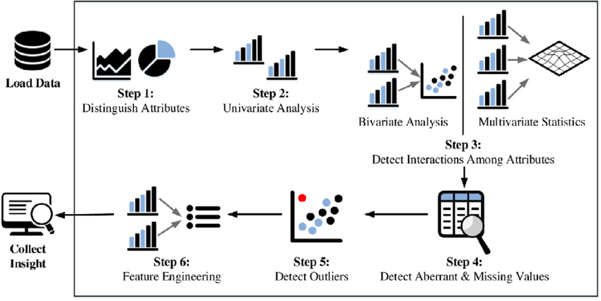
Note: The data and information in this document is reflective of a hypothetical situation and client. This document is to be used for KPMG Virtual Internship purposes only.
Data Exploration
The Importance of Conducting Exploratory Data Analysis:
Mitigates the potential for imbalanced dataset distribution by assessing the skewness of specific fields.
Identifies and addresses the risk of overfitting caused by high correlation among multiple variables through thorough correlation analysis.
Discerning superior variables/predictors among the existing ones, particularly those demonstrating significant correlation with the output variable.
Enhances dataset integrity by eliminating redundant values through comprehensive treatment of missing data and outliers.

Slide 5
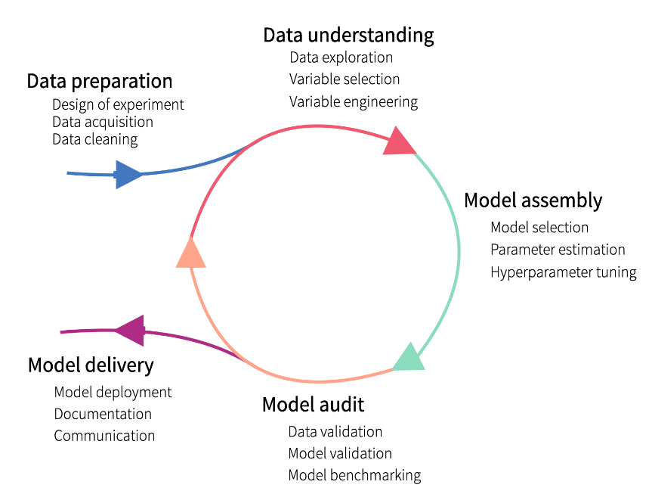
Note: The data and information in this document is reflective of a hypothetical situation and client. This document is to be used for KPMG Virtual Internship purposes only.
Model Development
  The process of model development is iterative, entailing the derivation, testing, and enhancement of numerous models until one meets the specified criteria.
The initial phase involves formulating a hypothesis addressing the problem statement, followed by rigorous statistical testing to validate its validity.
Assess the models' performance utilizing metrics like ROC Curves, Precision, Recall, AUC Curve, Accuracy, F1-score, and others.
Conclusively, implement and document the optimal model's performance, underlying assumptions, and identified limitations.

Slide 6
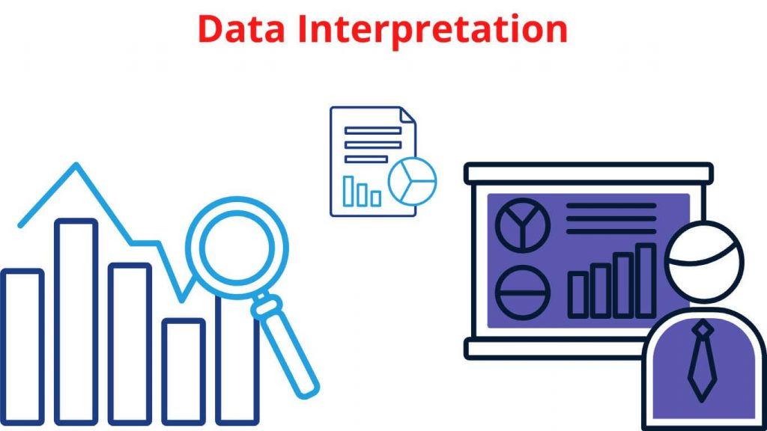
Note: The data and information in this document is reflective of a hypothetical situation and client. This document is to be used for KPMG Virtual Internship purposes only.
Interpretation
Culminating the data analysis process, data interpretation involves transforming results into a presentable format, yielding valuable and actionable insights for informed business strategies.
Pose pertinent questions for effective data interpretation.
Gather and integrate your data resources.
Select the appropriate visualization format.
Commence the process of data interpretation.
Maintain a focused and objective approach to interpretation.
Clearly annotate your discoveries and conclusions.

